Slide 1

Walmart sales project
using python and SQL(postgresql)

Slide 2




Walmart project pipelining
SQL Topics
Aggregation function.
Window function.
Date-Time functions.
Group by.
Process Data ,
Clean Data ,
Load into RDBMS(PostgreSQL)
Libraries used in Python
1.pandas.
2.psycopg2
3.sqlalchemy

Slide 3
PostgreSQL – CODES AND THEIR OUTPUT SNIPPETS BASED ON PROBLEM STATEMENTS

Slide 4
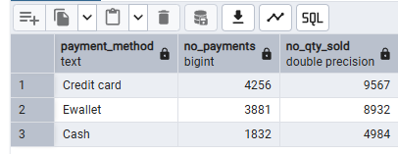
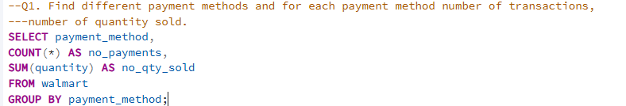
NUMBER OF TRANSACTION ON EACH PAYMENT METHOD

Slide 5
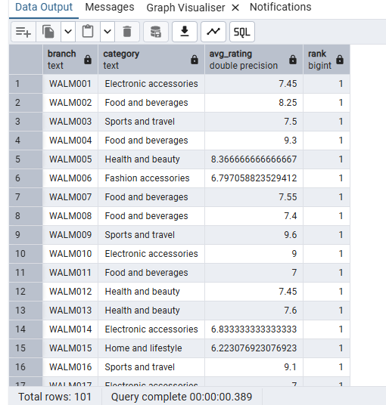
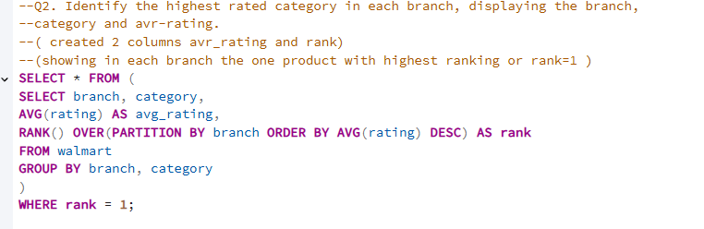
HIGHEST RATED CATEGORY IN EACH BRANCH

Slide 6
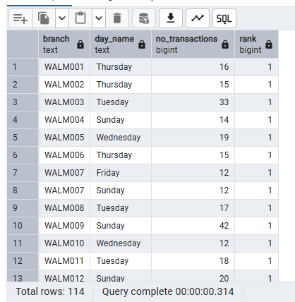
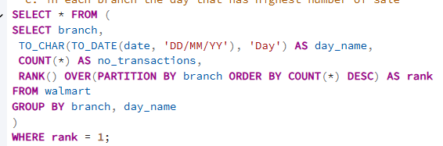
Identify the busiest day for each branch based on the number of transactions.

Slide 7
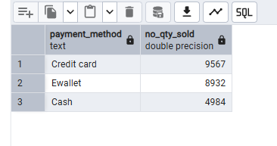

The total quantity of items sold per payment method

Slide 8
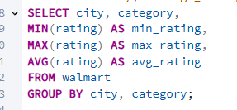
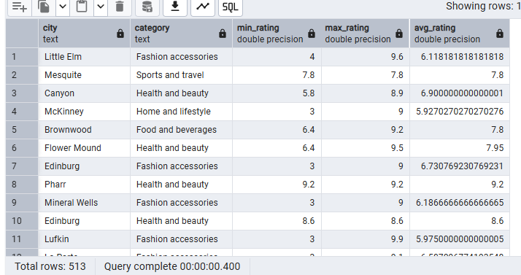
the average, minimum, and maximum rating of category for each city.

Slide 9
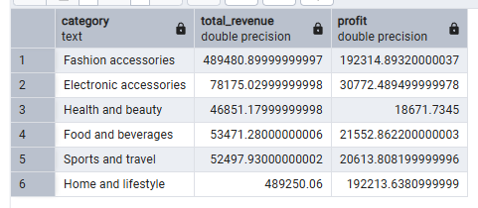
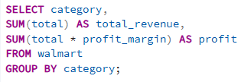
the total profit for each category

Slide 10
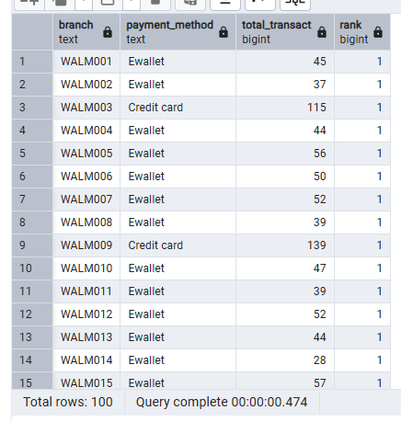
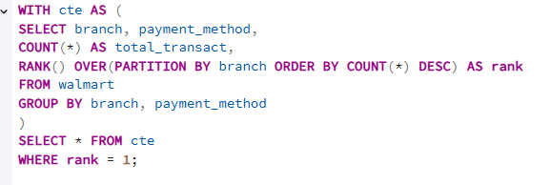
Determine the most common payment method for each branch. (display branch and the prefer ref_payment_method.)

Slide 11
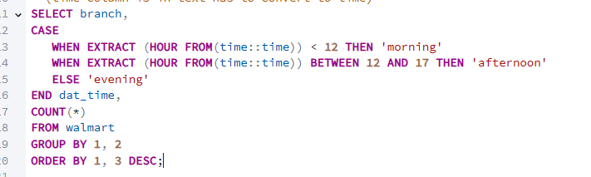
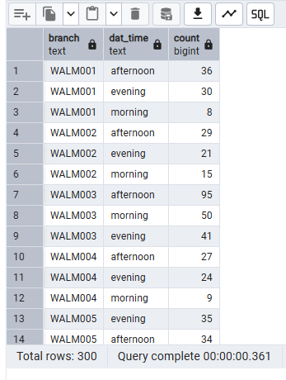
Categorize sales into 3 group MORNING, AFTERNOON, EVENING --Find out in each shift the number of invoices.

Slide 12
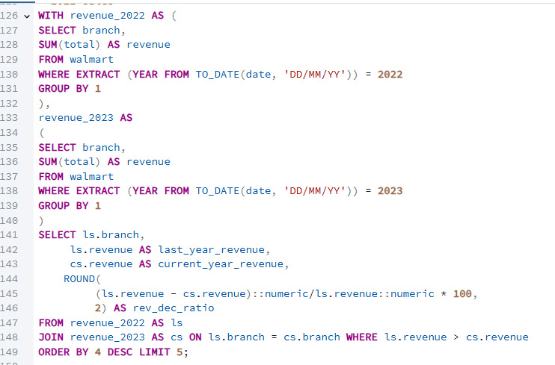
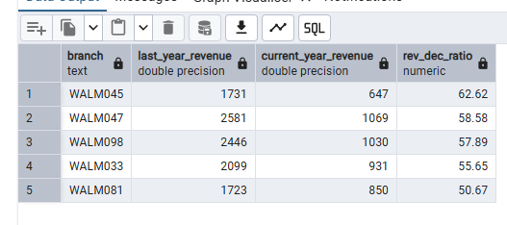
Identify the 5 branch with highest decrease ratio in revenue compare to last year --(current year 2023 and last year 2022)

Slide 13
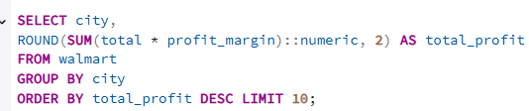
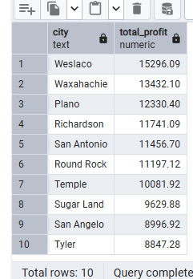
TOP 10 CITIES WITH THEIR REVENUE CONTRIBUTIONS IN WALMART SALES

Slide 14
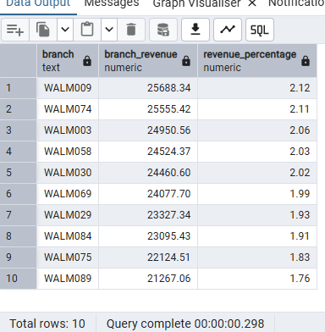
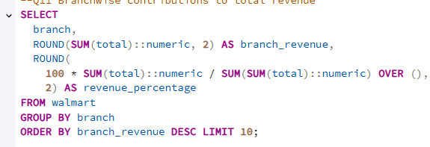
IDENTIFYING RESPECTIVE BRANCH CONTRIBUTION TO THE TOTAL REVENUE OF WALMART SALES

Slide 15
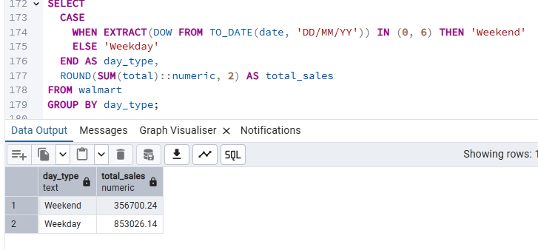
ANALYZING TOTAL SALES IN WEEKEND AND WEEKDAYS

Slide 16
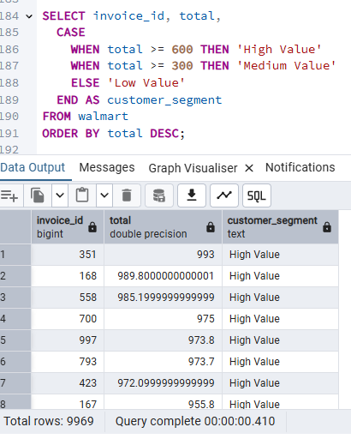
DIVIDING INVOICE BY APPLYING CUSTOMER SEGMENTATION

Slide 17
THANK YOU….

